Slide 1
Intro to Input and Interaction
CS 142
David Anderson
Slides by Martin Hock

Slide 2
Overview
We’ll learn about the String class today and how to get keyboard input
We’ll also learn about how to generate random numbers
We’ll start to work on an interactive game as an application of what we’ve learned so far

Slide 3
Strings and chars
Our very first program printed out a String:
System.out.println("Hello, World!");
Strings are objects, which can represent composite information
String s = "Hello, World!";
Strings are made up of individual symbols called characters (letters, digits, spaces, etc.)
Characters have their own primitive type in Java called char
We can write a char literal using single quotes:
char c = 'H';

Slide 4
String methods
We’ve defined our own static methods in Java
We have also called static methods like Math.pow
But we’ve also called object methods even though you didn’t know it
An example is System.out.println("Hello, World")
System.out is a PrintStream object
When we call System.out.println("Hello, World") we are telling the System.out object to print “Hello, World”
The System.out object is hooked up to the Eclipse console

Slide 5
Scanner
The Scanner class allows us to use System.in more easily (sort of like a chassis for an engine of a car
Scanner scanner = new Scanner(System.in);
You have to import java.util.Scanner (Eclipse should prompt you if you hover over the red underline)
You should only create one Scanner object for System.in or your program won’t work correctly!
We can retrieve a line of input from the user by calling the nextLine method on the Scanner object scanner
System.out.println("Please enter your name:");
String name = scanner.nextLine();
System.out.println("Hello, "+name+"!");

Slide 6
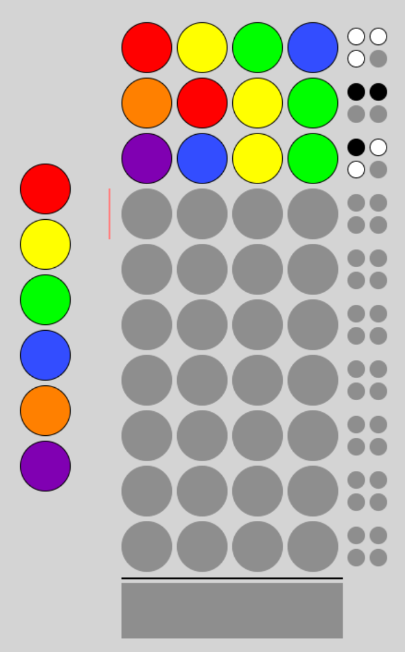
Example: Guessing game

Slide 7
Rules of guessing game
Computer creates a random hidden code of 4 colored circles taken from a palette of 6 colors
You make a guess of the code
The computer tells you how many colors are correct and in the right place by showing one black dot for each correct guess, and how many colors are correct but in the wrong place by showing one white dot for each

Slide 8
Example guess
Let’s use digits instead of colors for our version
Suppose the secret code is 1123
The user guesses 3141
The computer reports 1 correct guess and 2 correct letters

Slide 9
Random values
The game generates a random code to start with
To generate a random number in Java, we can call Math.random()
This returns a random double value ranging from 0 up to slightly less than 1 e.g. 0.6528383137255481 or 0.4693751071223585
This can be used by itself, e.g. in a comparison expression, or we can multiply it to scale it and cast the result to an int
Recall that casting to an int rounds down
For example, (int)(Math.random()*n) will evaluate to the values 0 through n-1 with roughly equal probability

